Slide 1
Azure API Application with .NET Core
Maik van der Gaag

Slide 2

Maik van der Gaag
Name: Maik van der Gaag
Function: Solution Architect at Motion10
Email: maik.vandergaag@motion10.com
Expertise: Office365,
Azure,
VSTS
Twitter: @maikvandergaag
Blog: https://msftplayground.com

Slide 3

Securing Data

Slide 4
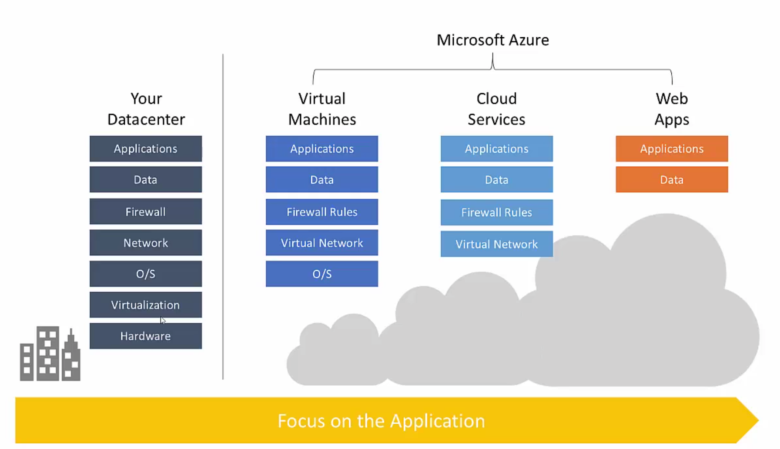

Slide 5


ASP.NET Core 1.0 and the modern web
Totally modular
Faster development cycle
Seamless transition from on-premises to cloud
Choose your editors and tool
Open source with contributions
OSS
Cross-platform
Fast

Slide 6



WPF
Windows Forms
ASP.NET
(4 & 5)
ASP.NET 5
Universal
Windows Apps
.NET Framework 4.6
.NET Core
CoreCLR
.NET Native
Fully-featured and integrated
.NET libraries and runtime for Windows
Modular and optimized
.NET libraries and runtimes
Shared
Runtime components
Libraries
Compilers
RyuJIT + SIMD
Garbage Collector
Base class libraries
NuGet packages
.NET Compiler Platform (Roslyn)
Languages innovation

Slide 7
Labs
1
2
3
4
Getting started with the Azure Api application
Extend the Azure Api App to pass through authentication to Azure SQL Database
Configure Azure Active Directory and the Api
Test Application

Slide 8
Let’s Go

